Slide 1
The Articles of Confederation
Essential Question: In what ways did the Articles of Confederation attempt to correct the problems of the colonial period?

Slide 2
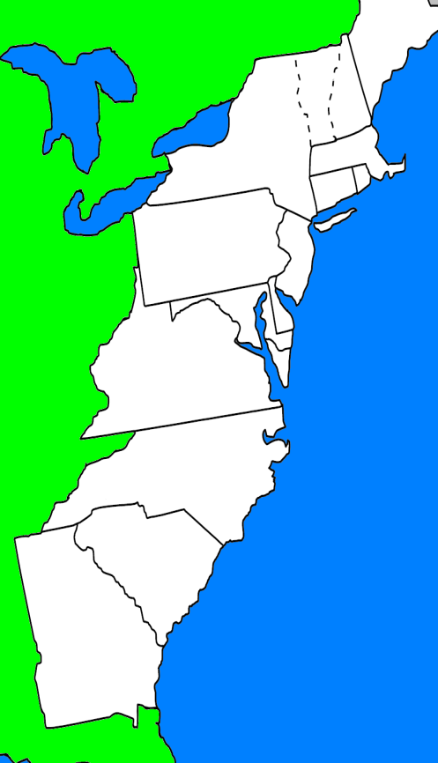
A “Confederation”
“League of Friendship” - Cooperation between states
The new states decided that they should form a weak central government to provide an army and to deal with foreign countries.

Slide 3
The Articles of Confederation
Structure of the new government:
No Executive Branch
No Court System
One branch called Congress

Slide 4
Weaknesses of the Articles of Confederation
Congress had NO
power to collect taxes
power to regulate trade
power to enforce laws

Slide 5
Weaknesses of the Articles of Confederation
Rules too rigid
Congress could NOT pass laws without the approval of 9 states
Could NOT be changed without the agreement of all 13 states

Slide 6
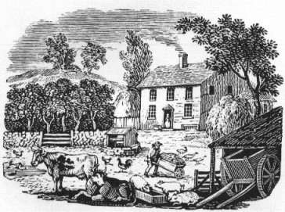
Problems Facing the Young Nation
USA faced a very high debt after the Revolutionary War
The national government could not impose taxes, so the individual states placed high taxes on their citizens.
This caused many businesses to fail, & many people lost their property

Slide 7
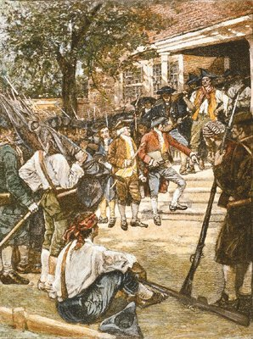
Shays’ Rebellion
Daniel Shays lost his farm in Massachusetts and then raised an army that marched through the countryside. They tried to prevent farms from being seized by the courts.
The national government had a difficult time stopping the rebellion, & people began to think that the government was too weak to protect them.

Slide 8
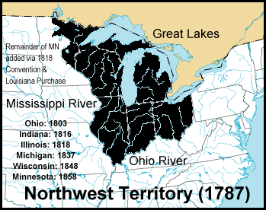
Northwest Ordinance - 1787
Passed by Confederation Congress
established a government for the Northwest Territory
outlined the process for admitting a new state to the Union
guaranteed that newly created states would be equal to the original thirteen states
protected civil liberties and outlawed slavery in the new territories

