Slide 1
Election of 1844 & Westward Expansion

Slide 2
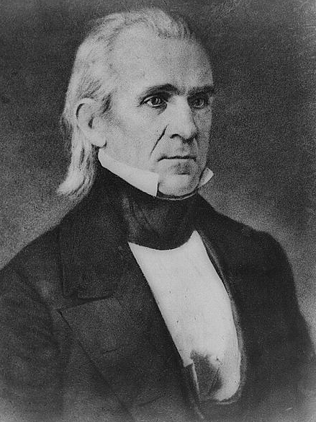
Election of 1844
Presidential Candidates
Whig:
Henry Clay
Opposed annexation
Democrat
James Polk
Supported annexation of Texas and Oregon
Believed in Manifest Destiny

Slide 3
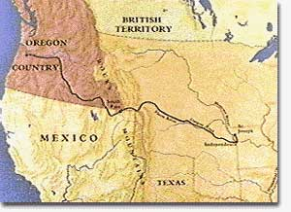
“54º 40’, or Fight!”
Polk vowed to grab all of Oregon Territory (Shared with Britain) to win the election
1846 Polk compromised with Britain, agreeing to split the Oregon Territory to the 49th Parallel
Compromised because US could not afford 2 wars
Wanted to fight weak Mexico instead of powerful Britain

Slide 4
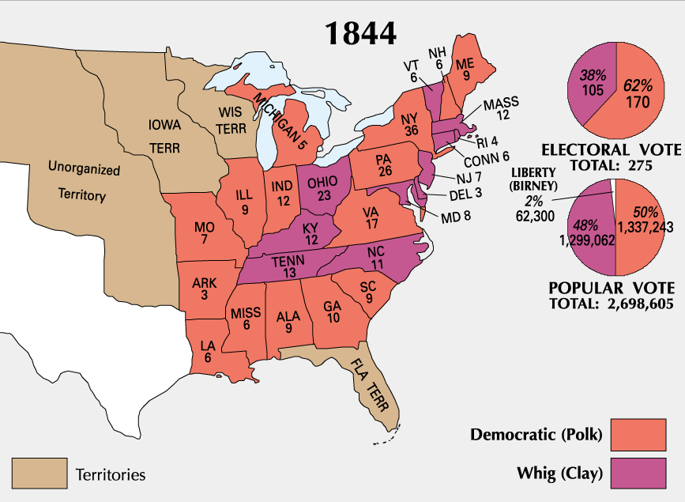
Election of 1844 Results

Slide 5
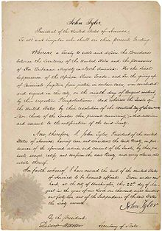
Webster-Ashburton Treaty 1842
Resolved several border issues between the United States and the British North American colonies

Slide 6
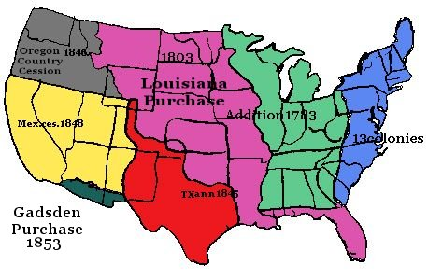
Westward Expansion 1820-1850

Slide 7
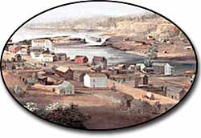
Why move west?
Cheap land
Climate
Independence
Isolation
Adventure

Slide 8
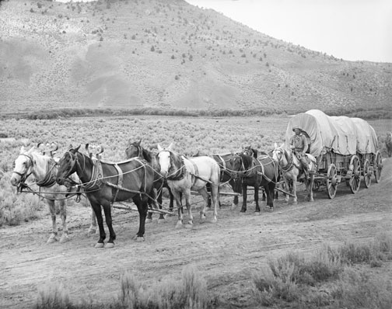
Traveling West
Approximately 300,000 people traveled the trail west
About 30, 000 people died en route west
Major causes of death: cholera, accidents and other diseases
Conflict with Native Americans was rare

Slide 9
Oregon Trail
Approximately 2000 miles long from Independence, Missouri to Oregon
Took about six months to travel
Window to leave Missouri was only a few weeks long—leave too early in Spring and the rivers are still flooded from snow and leave too late and get stuck in snow in mountains

Slide 10
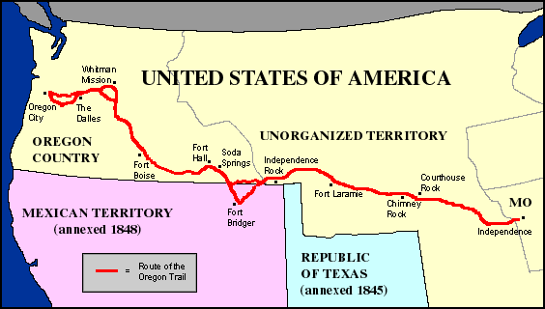
Oregon Trail

Slide 11
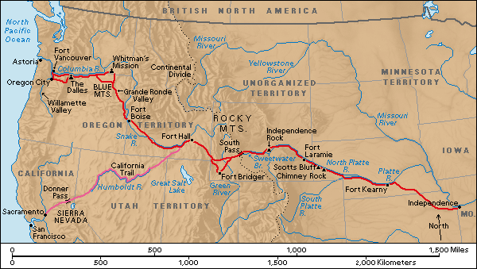
California Trail
Fort Hall, Oregon to Sacramento, California

Slide 12
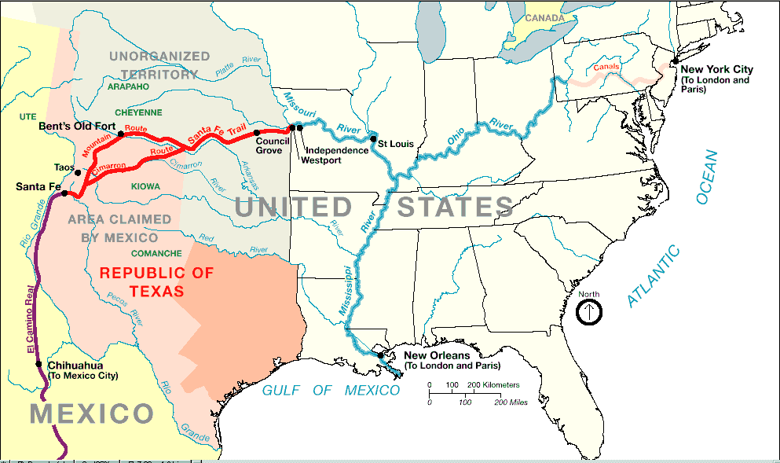
Santa Fe Trail
In exchange for American manufactured goods, the New Mexicans offered horses, mules, furs, etc.
Santa Fe, New Mexico to Los Angles, CA

Slide 13
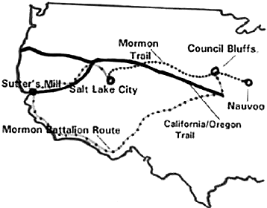
Mormon Trail
Nauvoo, Illinois to Salt Lake City, Utah

