Slide 1
English Political Traditions
What aspects of the English government do we use in the US today?

Slide 2
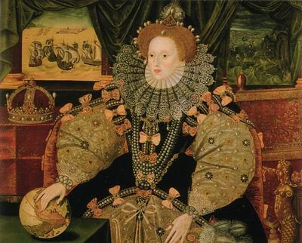
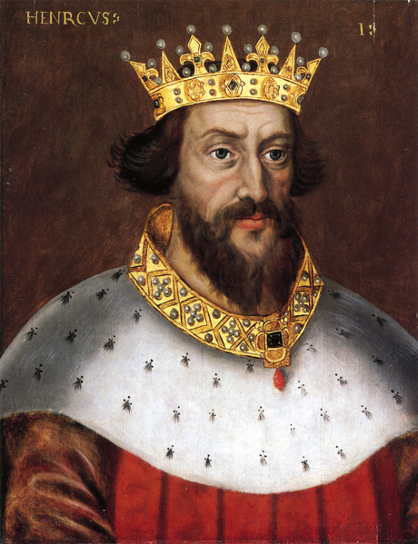
Absolute Monarchy
King William the Conqueror
Queen Elizabeth
King Henry 1
England was an absolute monarchy. This meant that their kings and queens had UNLIMITED power over the English people.
Notes:
Give students examples of the harsh treatment kings would use under the power of absolute monarchy.

Slide 3
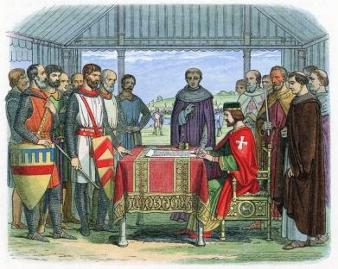
The Magna Carta
King John I was forced to sign
Guaranteed certain rights to the citizens of England.

Slide 4
The Magna Carta
Important rights established by the document and adopted by the US government include:
1. Accused people are guaranteed a trial with a jury. They are presumed innocent until proven guilty.
2. All citizens are guaranteed justice
3. All citizens, regardless of class, must follow the same laws and will be punished in the same way if they break a law.

Slide 5
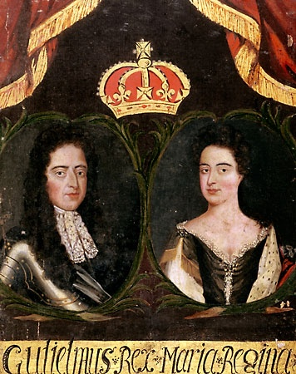
The Parliament
The Parliament: Originally a group of advisors to the monarch, the Parliament slowly took on more and more power. Today the Parliament has all powers of government in England.

Slide 6
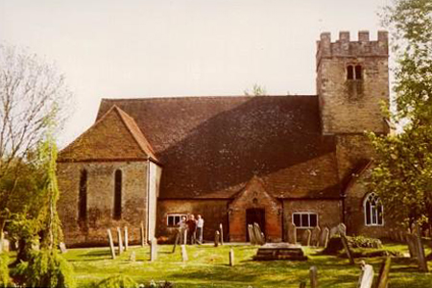
Road to a Glorious Revolution
Parliament
After a transfer of power to William and Mary there was a peaceful time called the Glorious Revolution. From this time on no ruler would have more power than Parliament.
Notes:
Explain the progression of meeting in churches to growing into a larger body of common people that developed legislature know as Parliament.

Slide 7
Bill of Rights…does this sound familiar?
1689
Parliament wrote the
English Bill of Rights
Free election to Parliament
Right to a fair trial
elimination of cruel and unusual punishments
Notes:
Make sure you make the connection for the point of the Power Point. It’s to see the influence England’s government had on the colonies. Drawing attention to the bill of rights will have recapture that connection.

Slide 8
British Common Law
Courts’ decisions became the basis of law
When the judges would look to decide cases, they would look for a
PRECEDENT, or a ruling in
an earlier case that was similar.

Slide 9
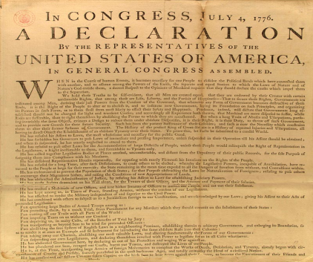
Road to Self Government
House of Burgesses
Fundamental Order of Connecticut
Salutary neglect
Mayflower Compact
Notes:
Give students an idea of terms they will hear in the next few slides.

Slide 10
Jamestown
1612
After the establishment of Jamestown the 1st legislature was created. It was called the
House of Burgesses.

Slide 11
Mayflower Compact
Pact to have a direct democracy.
Town hall meetings
Local town government
Notes:
Make the connection to government today.

Slide 12
Fundamental Orders of Connecticut
1639 In Connecticut the first constitution was written called the
Fundamental Orders of Connecticut
It stated:
That the assembly of elected representatives from each town to make laws.
There would be a popular election of a governor and judges
Notes:
Again, make the connection with how we elect officials today.

Slide 13
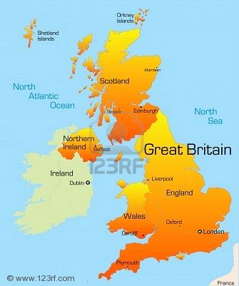
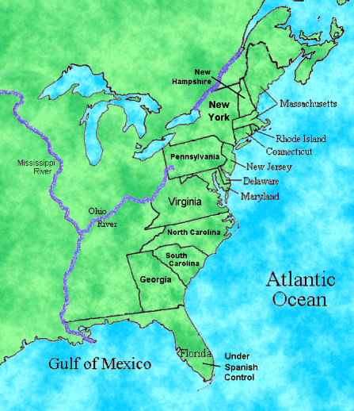
Salutary Neglect
Separated by more than 3000 miles, Great Britain still had loose control over the colonies which they called
salutary neglect.
The colonies were self governing and taking care of their own problems while England was focused on problems in England.

Slide 14
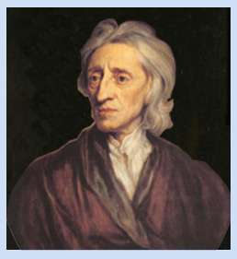
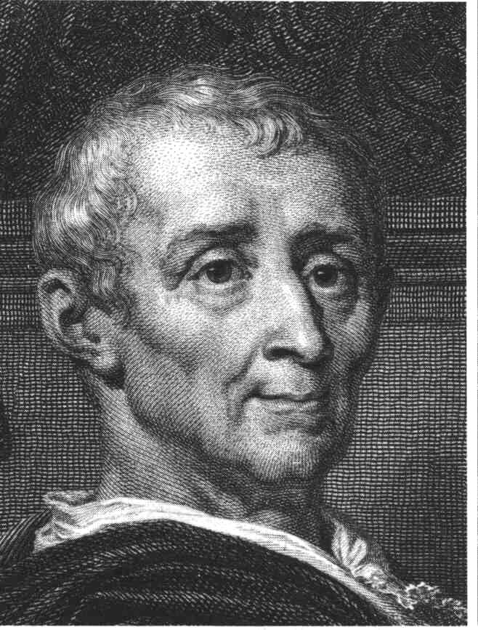
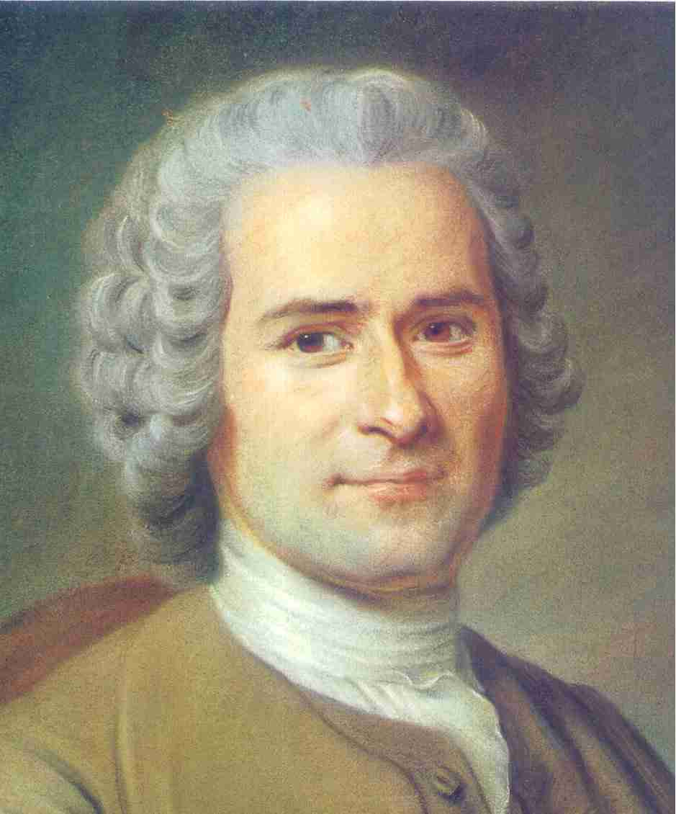
Enlightenment Philosophy
The Enlightenment was a time when people in Europe began to question the traditional ideas about government and power, and came up with new ideas about who should be involved in government.
Several important writers of the 1700s helped pave the way for the American Revolution.

Slide 15
John Locke
The most important Enlightenment philosopher in the design of the government of the United States.
Natural Rights
“life, liberty, and property”
Social Contract

Slide 16
The Social Contract Theory

Slide 17
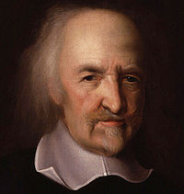
Enlightenment Philosophers
Thomas Hobbes- man's natural state is anti-social, and that moral rules are created to avoid chaos

Slide 18
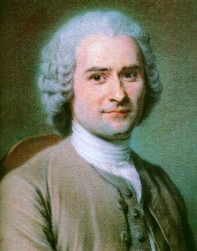
Montesquieu and Rousseau
Baron de Montesquieu: Separation of Power → powers of government should be divided into branches (Legislative Branch: Makes Laws; Executive Branch: Enforces Laws; Judicial Branch: Interprets Laws)
Jean-Jacques Rousseau: “All Men Are Created Equal”

Slide 19
Social Contract Theory
Your group is responsible for creating a contract for your class
List 10 rights that you want the teacher to protect
Choose one person from your group to be the spokesperson

