Slide 1
Minorities in the new world
Unequal in the Land of Equality

Slide 2
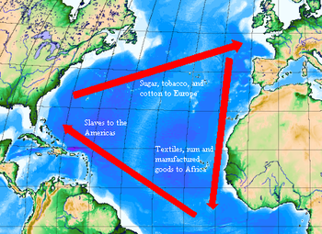
Triangular Trade Route between Europe, Africa, and the New World

Slide 3
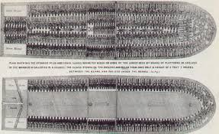
The Middle Passage
Specific name given to the part of the triangular trade between Africa and the Americas
Transported across the Atlantic to serve as slaves in the new world (10-40% died)

Slide 4
Servants and Slaves
Indentured Servants
Slaves
Working on a 4-7 year contract to work off the trip to the new world
Ran away difficult to recover
Every 5 years, retrain workers
In time cost less
Slave codes
Laws controlled every aspect of a slave’s life

Slide 5
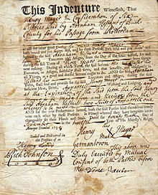
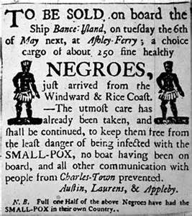
Servants and Slaves

Slide 6
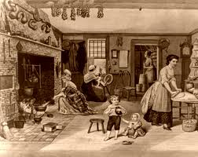
Women
By 1624, fewer than 18% of the colonies were made up of women

Slide 7
Women’s Rights
Young girls were often married by the age of 13 or 14
Women weren’t married by the age of 25, humiliating
Marriage was mostly for economic benefits
Laws were proposed that would force widows to marry within 7 years after their husband’s death
Women were considered legally dead once they were married
Husbands could legally beat their wives
If a woman ran away from her husband, she was considered a thief
If a man murdered his wife, he would be hung. If a woman murdered her husband, she would be burned alive.

Slide 8
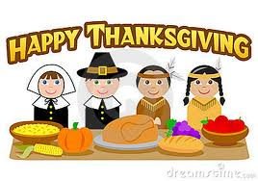
Native Americans

Slide 9
Which video is most accurate?
http://www.youtube.com/watch?v=faUYJ9fMiGg
http://www.youtube.com/watch?v=haJzFXmmroo
http://www.youtube.com/watch?v=zrArbtXNbnM

Slide 10
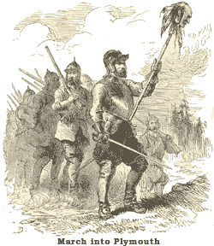
King Philip’s War 1675-1676
Conflict between Wampanoags and English settlers (Massachusetts) led to war
Wampanoag Leader:
Chief Metacomet (King Philip)
Sparked by the English
settlers encroachments on
native lands
Indians succeeded in
forcing back the line of
Settlement but lost
independence

Slide 11
1675-1676 Bacon’s Rebellion
Led by Nathaniel Bacon
Violent conflict in Virginia
Settlers attack Indians (land)
Against government (Governor Berkley)
Irresponsibility and the failure to perform his duty as Governor
Bacon issued a “Declaration of the People of Virginia”
1st rebellion in the 13 colonies

Slide 12
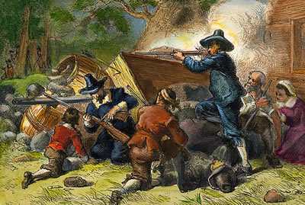

Slide 13
Exit Ticket
As we can see minorities were not treated as equals during the early origins of America. However, later in American history, key people from minority groups changed the nation.
Write about which minority group you believe face the most hardships in America today. Why?

