Slide 1
North American Exploration
Unit 1

Slide 2
Direct Causes – 3 G’s
GLORY, GOLD, GOD
Primary reasons for European exploration
3 motives reinforce each other

Slide 3
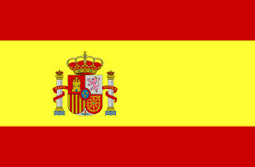
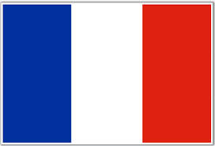
3 G’s cont.
GLORY - political
Goal of a country was to become a world power by gaining wealth and land

Slide 4
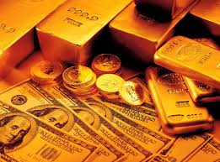
3 G’s Cont.
GOLD – economic
Goal was to search for new trade routes to Asia to increase trade for luxury goods

Slide 5
3 G’s Cont.
GOD – religion
Goal was to spread Christianity and weaken other religions

Slide 6
Defeat of Spanish Armada
In 1588, the British navy defeats the Spanish Armada
Makes Great Britain the premier power in Europe and on open seas
North America is for the picking – why do we speak English?

Slide 7
Reformation
Reformation in 16th century leads to religious persecution in Europe
Religious groups flock to the new world in search of religious freedom – Pilgrims, Puritans, Quakers, etc.

Slide 8
Mercantislism
Mercantilism – economic policy during 17th and 18th century in Europe
Goal was to acquire colonies for economic gain through trade
control raw materials and markets
make sure exports > imports

Slide 9
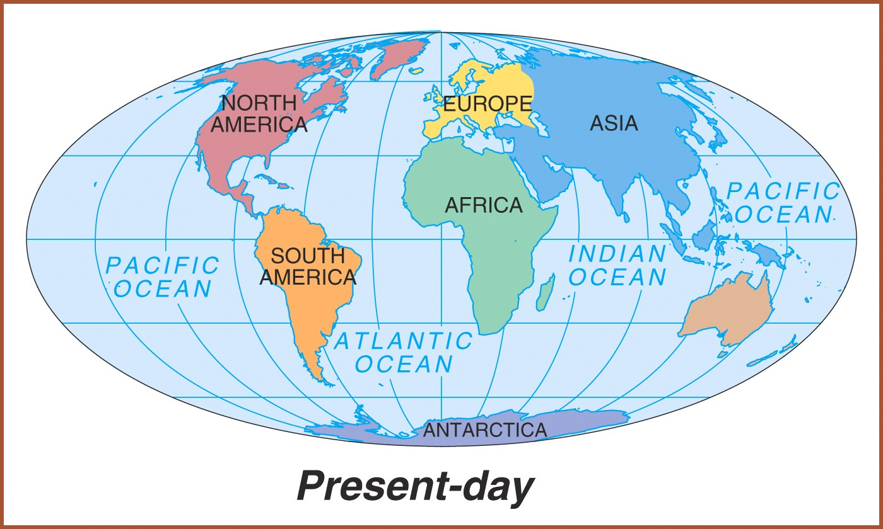
Columbian Exchange
Exchange of things between old and new world
animals, plants, culture, disease & technology

Slide 10
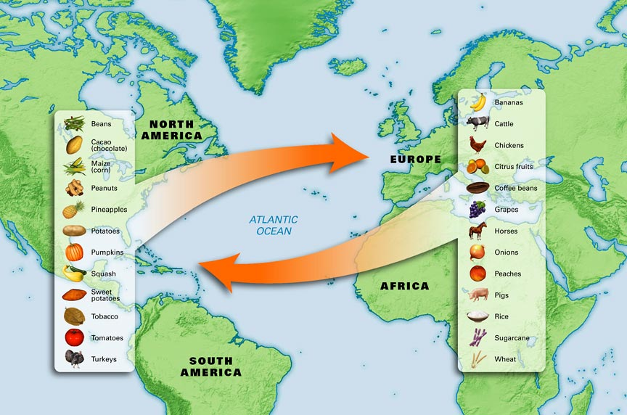
Columbian Exchange

Slide 11
Spanish Exploration
Christopher Columbus – 1492 – Italian sailing for Spain – lands in Bahamas
Three ships – Nina, Pinta, Santa Maria
Called natives – Indians - thought he had made it to India

Slide 12
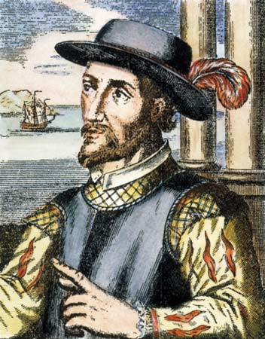
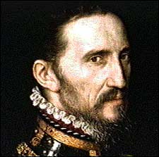
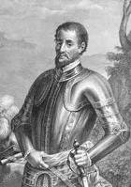
Spanish Exploration cont.
Ponce De Leon - Established colony at Puerto Rico - Sailed north looking for Fountain of Youth - Discovered Florida – 1508
Francisco de Coronado - Explored north from Mexico; up Colorado River; saw Grand Canyon -1540
Hernando de Soto - Explored Florida into Carolina’s and west to the Mississippi River - 1541

Slide 13
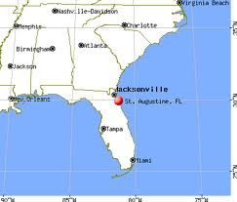
Spanish Exploration cont.
First permanent colony in what will become the U.S. was founded by Spain
St. Augustine (Florida) founded in 1565

Slide 14
French Exploration
Samuel de Champlain – Established Quebec in 1608
Joliet and Marquette – 1st Europeans to discover the Mississippi River
Rene-Robert Lasalle – followed Mississippi River all the way to Gulf of Mexico – named it Louisiana after King Louis XIV

Slide 15
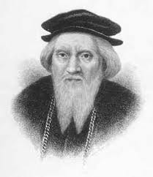
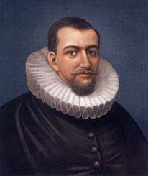
English Exploration
John Cabot – trying to get to Asia he lands in Nova Scotia and given credit for “new found land”
Henry Hudson – searching for Northwest Passage – claims Hudson Rivers and established New Netherlands (New York) in 1609

