Slide 1
Salem Witch Trials
1692-1693

Slide 2
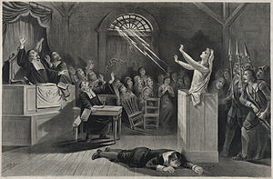
Overview
Over 200 people accused of practicing the “Devil’s Magic”
20 were executed

Slide 3
King William’s War
English rulers William and Mary began a war with France in the colonies
War created problems for people of Salem
Conflict between wealthy and poor erupted
People felt it was the work of the devil

Slide 4
The Beginning
3 young girls began having “fits” including the daughter of the unpopular pastor of Salem
3 girls blamed 3 women for causing these “fits”
Tituba, Sarah Good, and Sarah Osborne (all poor)
Tituba claimed she was possessed, 2 others claimed innocence

Slide 5
Bridget Bishop
First to be executed
Claimed her innocence but was known for her habits of gossip
18 were hanged, one man was pressed to death by stone

Slide 6
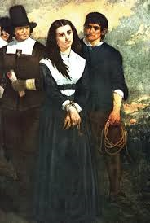
Bridget Bishop

Slide 7
Governor Phipps
Had established a special court to hear cases
Allowed spectral evidence (testimony about dreams)
Phipps prohibited further arrests after his wife was accused of witchcraft
Disallowed spectral evidence in court

Slide 8
First Great Awakening
After events such as Salem Witch Trials, people felt dryness towards religion
Church of England was only religion permitted in the colonies
People wanted to revive religion
Made religion more personal

