Slide 1
Texas Fights for Independence

Slide 2
Mexico’s Province
Mexico wanted to populate Texas which only had 4,000 residents
Encouraged Americans to settle in Texas by giving them cheap land

Slide 3
Mexico’s Province cont.
In return, Americans had to agree to:
Become Mexican citizens
Adopt Catholicism
Accept the Mexican constitution which banned slavery

Slide 4
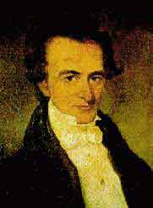
Stephen F. Austin
Led Americans into Texas from the South called Anglo-Texans
Sought economic opportunity in farming
By 1835, 30,000 Americans outnumbering the Mexicans 6 to 1

Slide 5
Tension Increases
Anglo-Texans began to reject the Mexican government by 1830
They continued to practice Protestant religions.
They never abandoned slavery.

Slide 6
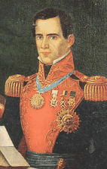
Santa Anna
In 1834, Santa Anna seized control of Mexico as a dictator
Anglo-Texans fear his power and long for the democracy of the U.S.
In 1835, Texans rebelled against Mexican rule

Slide 7
The Alamo
In March 1836, Santa Anna lead between 1800 and 6000 troops into San Antonio
After 12 days of cannon fire, Mexican troops overran the walls of the former mission
Santa Anna ordered all defenders (200) to be killed
Only a handful were spared

Slide 8
The Alamo cont.
Deaths included Davy Crockett, Jim Bowie and William Travis
Santa Anna spared one woman and her daughter and sent them to Sam Houston
Sam Houston (leader of the resistance) was warned that all Texans would suffer a similar fate if they continued the revolt

Slide 9
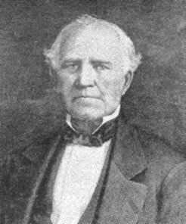
Battle of San Jacinto
In April 1836, Sam Houston with 800 Texans defeat Santa Anna in battle close to Houston
630 Mexicans are killed with 730 taken prisoner including Santa Anna
Only 32 Texan casualties

Slide 10
Battle of San Jacinto cont.
Battle cry was “Remember the Alamo”
Fearing execution – Santa Anna agreed to treaty recognizing Texan independence
Established southern boundary at Rio Grande River though Mexican Government would dispute the southern boundary for next ten years with Nueces River

Slide 11
Texas Annexation
Texas elected Sam Houston as their first president
He immediately asked U.S. to annex Texas
This would lead to a decade long debate
U.S. refused annexation because:
It would add an additional slave state
It would increase threat of war with Mexico

