Slide 1
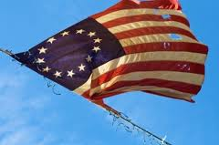
The War for Independence
1775-1783

Slide 2
Advantages
Colonists
- Fighting on home ground
- Fighting for rights and freedoms
- Help from the French
British
- Well trained & supplied army and navy
- Strong central government
- Wealth of resources
Disadvantages
Colonists
- Untrained soldiers; small army
- Food & weapon shortages
- Weak central government
British
- Fighting in hostile territory
- Fighting far away from resources
- Troops don’t really care

Slide 3
Lexington & Concord
April 18, 1775 – 700 British troops leave Boston for Concord (supply depot)
Revere set out to warn the minutemen – reached Lexington by midnight – headed to Concord
British troops encounter 70 patriots in Lexington (nobody knows who fired the first shot) – 8 killed and 10 wounded
British head toward Concord

Slide 4
Lexington & Concord
British realize supplies have been moved
Begin fight with 400 colonial militia – British retreat back to Boston
Upon their arrival – British had 99 dead and 174 wounded
Colonists suffered 49 dead and 46 wounded
News of the battles spread throughout the colonies

Slide 5
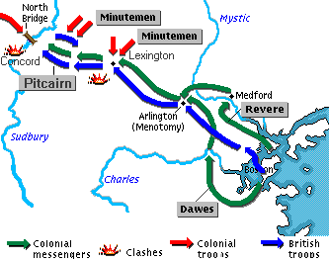
Lexington & Concord

Slide 6
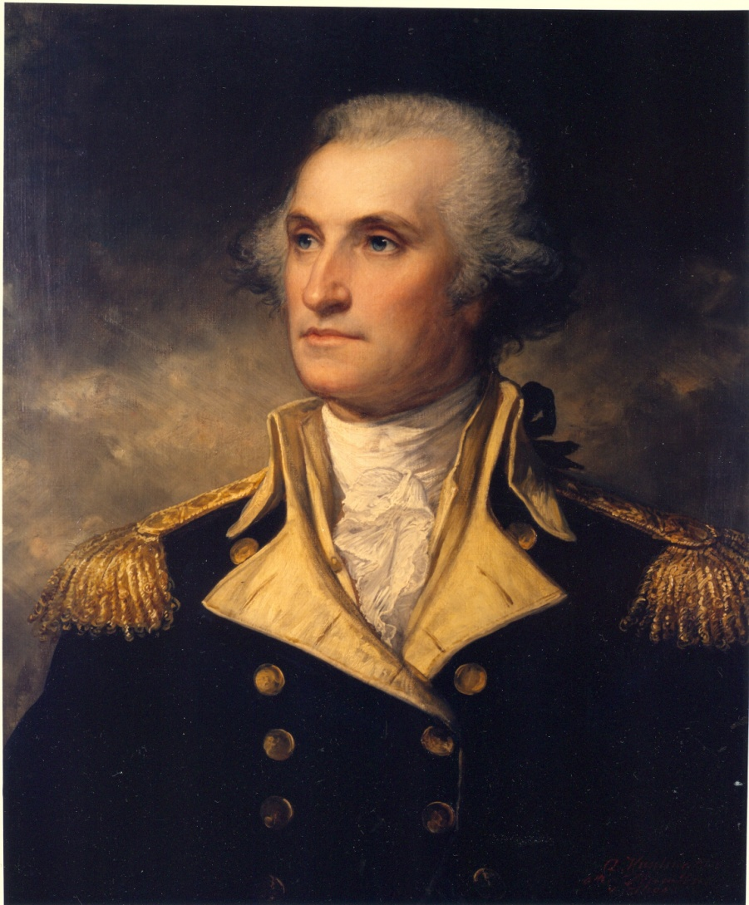
Second Continental Congress
Meet 3 weeks after Concord
Adopt a militia army to surround Boston – known as Continental Army
George Washington chosen to be general & commander in chief of new army

Slide 7
Battle of Bunker Hill (Breed’s Hill)
British sent reinforcements to Boston
Colonists begin to build for on Breed’s Hill
Gen. Cage will send 2,200 to seize hill
Colonists told “don’t fire until you see the whites of their eyes”
Successfully fend British off on first 2 tries – fail on third try because they run out of ammunition

Slide 8
Northern Campaign
British want to win the war quickly by winning several battles early
Capture New York City then separate New England from South
Try to convince colonists to not fight and they would be pardoned

Slide 9
Nathan Hale
After losing New York City in 1776, Washington sent Hale to be a spy in the city (British headquarters)
Though Hale disguised as a Dutch school teacher, he was captured and hanged
Hale’s last words: “I only regret that I have but one life to lose for my country”

Slide 10
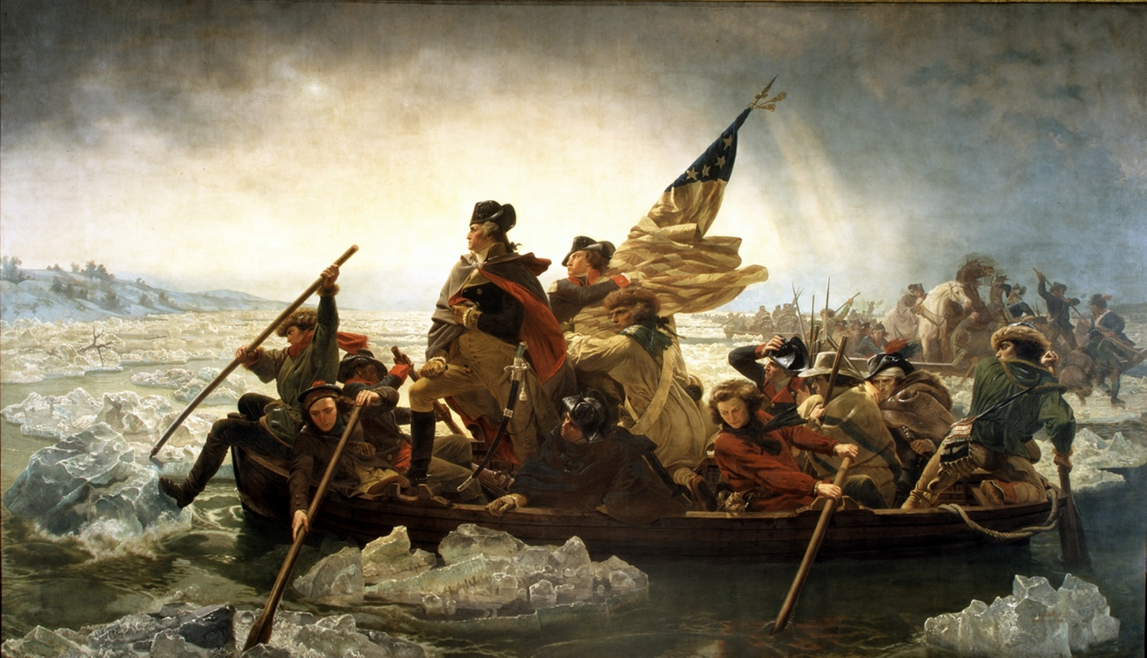
Crossing the Delaware
What are the events surrounding this image?

Slide 11
Crossing the Deleware
After defeating colonists in White Plains, NY – British turn attention toward Philadelphia and not chasing the retreating Washington
Before either group can get there, winter sets in and both sides settle in for Winter (British in New Jersey and Washington in Pennsylvania)
Washington does surprise attack on British picking up 2 victories

Slide 12
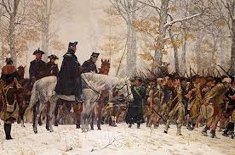
Valley Forge, Pennsylvania
What hurdles does George Washington face?

Slide 13
Valley Forge, Pennsylvania (-)
Winter of 1777 to 1778 was brutally cold with colonists lacking food, clothing & other supplies
“Our troops are in general almost naked and very often in starveing condition. All my men except 18 are unfit for duty for want of shoes, stockings, and shirts . . . Poor Jack has been necessitated to make up his blanket into a vest and breeches.”
Washington loses close to 2,500 men that winter

Slide 14
Valley Forge, Pennsylvania (+)
Two European military officers helped train Washington’s troops
Marquis de Lafayette (France)
Baron Friedrich von Steuben (Prussia)
Improved discipline and boosted morale

Slide 15
Saratoga
Colonists win major victory in New York
Turning point of the war because it encourages France to commit troops
The victory proved the colonists were legit

Slide 16
Southern Campaign
British were willing to fight to keep just the South even if it lost the North
British troops win major victories at Savannah and Charles Town
Move inland relying on Loyalist troops to help fight
Turning point for South occurs at Kings Mountain where British are defeated and forced to retreat back to the coast

Slide 17
Yorktown
British maintained a stronghold in Virginia until Washington surrounded Yorktown with Colonists and French
October 19, 1781 – 8,000 British troops surrender under leadership of General Cornwallis
This was the last battle of the war

Slide 18
Treaty of Paris
Peace negotiations began led by Benjamin Franklin, John Adams and John Jay
Signed on September 3, 1783
Britain recognized United States of America as a new nation with its western boundary the Mississippi River
Britain gave Florida back to Spain
France received colonies back from Britain in Africa and Caribbean

Slide 19
The Stars & Stripes
June 14, 1777 – Continental Congress designed the first flag
13 stripes representing each colony
13 stars in blue representing a new constellation

Slide 20
The 4th of July
On July 2, 1776 – Second Continental Congress voted to declare U.S. independent from Britain
On July 4, 1776 – they approved the Declaration of Independence
On July 3, John Adams wrote this to his wife Abigail
- The second day of July, 1776, will be the most memorable epoch in the history of America. I am apt to believe that it will be celebrated by succeeding generations as the great anniversary festival. It ought to be commemorated as the day of deliverance, by solemn acts of devotion to God Almighty. It ought to be solemnized with pomp and parade, with shows, games, sports, guns, bells, bonfires, and illuminations, from one end of this continent to the other, from this time forward forever more.

